Slide 1
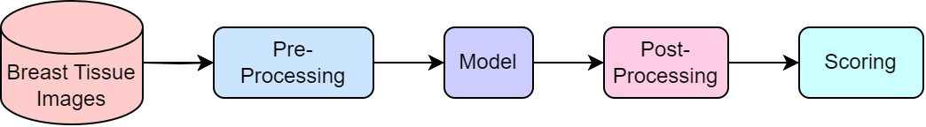
Convolutional Neural Network
Notes:
Leo
-------------------------------------
When it comes to image recognition, there Is a model that excels in this. That is the convolutional neural network, CNN for short. CNNs are very good at learning features by themselves and operate by successively convolving input to reach a class label.
This is how the CNN operates
In the base layer, the convolution happens here. There are many operations that go on here such as multiple convolutions and activation functions.
The pooling layer condenses these output of the base layer into fewer features.
Then it goes to the flattening layer strings the features together into a single vector.
The dense layer also called the fully connected layer, takes the vector and connects all of the computed data so the model knows that the data are related in a way. and last produces a final prediction, the classification.
However, CNNs are much more difficult to implement, since the whole structure has to be customized and refined based on the results.
In the meantime, we are using a generic prebuilt algorithm to generate results.
-----------------------------

Slide 2
CNN Input Data
PC1 | PC2 | PC3 | PC4 | PC5 | PC6 | PC7 | PC8 | PC9 | PC10
Notes:
Leo
-------------------------------------
When it comes to image recognition, there Is a model that excels in this. That is the convolutional neural network, CNN for short. CNNs are very good at learning features by themselves and operate by successively convolving input to reach a class label.
This is how the CNN operates
In the base layer, the convolution happens here. There are many operations that go on here such as multiple convolutions and activation functions.
The pooling layer condenses these output of the base layer into fewer features.
Then it goes to the flattening layer strings the features together into a single vector.
The dense layer also called the fully connected layer, takes the vector and connects all of the computed data so the model knows that the data are related in a way. and last produces a final prediction, the classification.
However, CNNs are much more difficult to implement, since the whole structure has to be customized and refined based on the results.
In the meantime, we are using a generic prebuilt algorithm to generate results.
-----------------------------

Slide 3
CNN Convolution Layer
Output Value 1
Output Value 2
Output Value 3
Output Value 4
Output Value 5
Output Value 6
Output Value 7
Output Value 8
PC1 | PC2 | PC3 | PC4 | PC5 | PC6 | PC7 | PC8 | PC9 | PC10
Notes:
Leo
-------------------------------------
When it comes to image recognition, there Is a model that excels in this. That is the convolutional neural network, CNN for short. CNNs are very good at learning features by themselves and operate by successively convolving input to reach a class label.
This is how the CNN operates
In the base layer, the convolution happens here. There are many operations that go on here such as multiple convolutions and activation functions.
The pooling layer condenses these output of the base layer into fewer features.
Then it goes to the flattening layer strings the features together into a single vector.
The dense layer also called the fully connected layer, takes the vector and connects all of the computed data so the model knows that the data are related in a way. and last produces a final prediction, the classification.
However, CNNs are much more difficult to implement, since the whole structure has to be customized and refined based on the results.
In the meantime, we are using a generic prebuilt algorithm to generate results.
-----------------------------

Slide 4
CNN Convolution Output
Filter 1 Output
Value 1
Value 2
Value 3
Value 4
Value 5
Value 6
Value 7
Value 8
Filter 2 Output
Value 1
Value 2
Value 3
Value 4
Value 5
Value 6
Value 7
Value 8
Filter 3 Output
Value 1
Value 2
Value 3
Value 4
Value 5
Value 6
Value 7
Value 8
Notes:
Leo
-------------------------------------
When it comes to image recognition, there Is a model that excels in this. That is the convolutional neural network, CNN for short. CNNs are very good at learning features by themselves and operate by successively convolving input to reach a class label.
This is how the CNN operates
In the base layer, the convolution happens here. There are many operations that go on here such as multiple convolutions and activation functions.
The pooling layer condenses these output of the base layer into fewer features.
Then it goes to the flattening layer strings the features together into a single vector.
The dense layer also called the fully connected layer, takes the vector and connects all of the computed data so the model knows that the data are related in a way. and last produces a final prediction, the classification.
However, CNNs are much more difficult to implement, since the whole structure has to be customized and refined based on the results.
In the meantime, we are using a generic prebuilt algorithm to generate results.
-----------------------------

Slide 5
CNN Max Pooling Layer
Filter 1 Output
1
4
3
Value 1
Value 2
Value 3
2
5
3
1
2
Value 4
Value 5
Value 6
Value 7
Value 8
4
3
5
2
Notes:
Leo
-------------------------------------
When it comes to image recognition, there Is a model that excels in this. That is the convolutional neural network, CNN for short. CNNs are very good at learning features by themselves and operate by successively convolving input to reach a class label.
This is how the CNN operates
In the base layer, the convolution happens here. There are many operations that go on here such as multiple convolutions and activation functions.
The pooling layer condenses these output of the base layer into fewer features.
Then it goes to the flattening layer strings the features together into a single vector.
The dense layer also called the fully connected layer, takes the vector and connects all of the computed data so the model knows that the data are related in a way. and last produces a final prediction, the classification.
However, CNNs are much more difficult to implement, since the whole structure has to be customized and refined based on the results.
In the meantime, we are using a generic prebuilt algorithm to generate results.
-----------------------------

Slide 6
CNN Fully Connected Layer
6
Class Probabilities
3
50%
30%
10%
10%
Class 1
Class 2
Class 3
Class 4
8
Notes:
Leo
-------------------------------------
When it comes to image recognition, there Is a model that excels in this. That is the convolutional neural network, CNN for short. CNNs are very good at learning features by themselves and operate by successively convolving input to reach a class label.
This is how the CNN operates
In the base layer, the convolution happens here. There are many operations that go on here such as multiple convolutions and activation functions.
The pooling layer condenses these output of the base layer into fewer features.
Then it goes to the flattening layer strings the features together into a single vector.
The dense layer also called the fully connected layer, takes the vector and connects all of the computed data so the model knows that the data are related in a way. and last produces a final prediction, the classification.
However, CNNs are much more difficult to implement, since the whole structure has to be customized and refined based on the results.
In the meantime, we are using a generic prebuilt algorithm to generate results.
-----------------------------

Slide 7
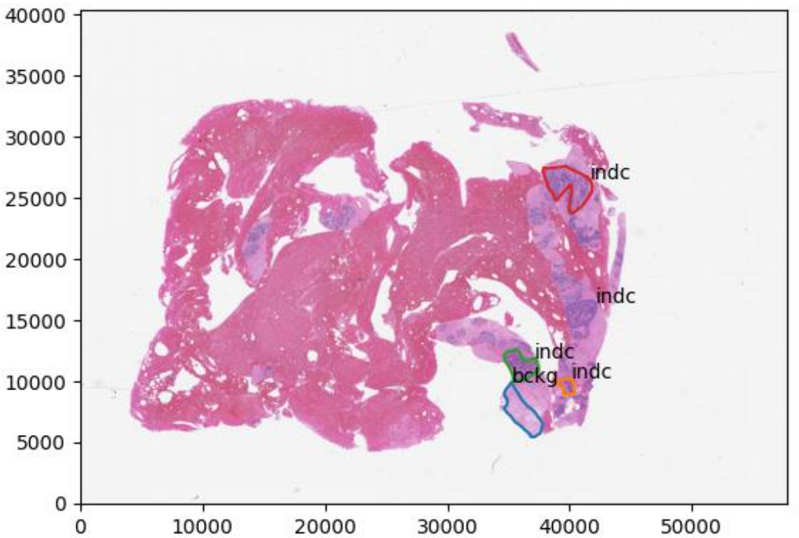
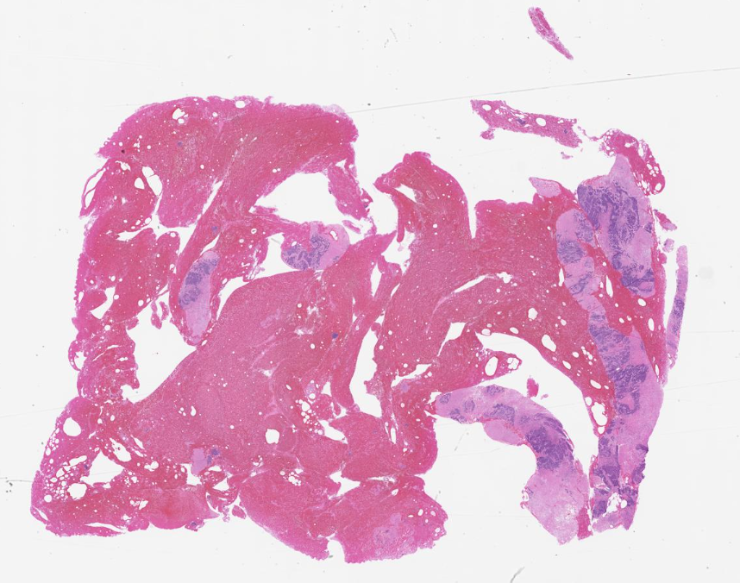
Frame Identification
Vertical Pixel Index
Horizontal Pixel Index
Notes:
Yuan
There are three levels that we have to get through: frame level, patch level, and image level
Lets start with the frame level first.
This image is a random slide pulled from our data with the x and y axis as pixels of the image.
Here’s a visual representation of that.
From our parameters, we get the frame size and window size
Segment the image by the framesize
The window size must be bigger than the frame so it could provide some context from the surrounding frames
We start iterating through each frame starting from the top left
As the image iterates through each frame, it will make predictions on the frames, whether malignant or nonmalignant.

Slide 8
Frame Identification Output
Vertical Pixel Index
Horizontal Pixel Index
Notes:
Albert
We make a copy of the image, use a flood-fill algorithm to flood the outer area with malignant labels, and invert the image, so malignant become non-malignant and visa versa.

Slide 9
Flood Fill Algorithm
Vertical Pixel Index
Horizontal Pixel Index
Notes:
Albert
We make a copy of the image, use a flood-fill algorithm to flood the outer area with malignant labels, and invert the image, so malignant become non-malignant and visa versa.

Slide 10
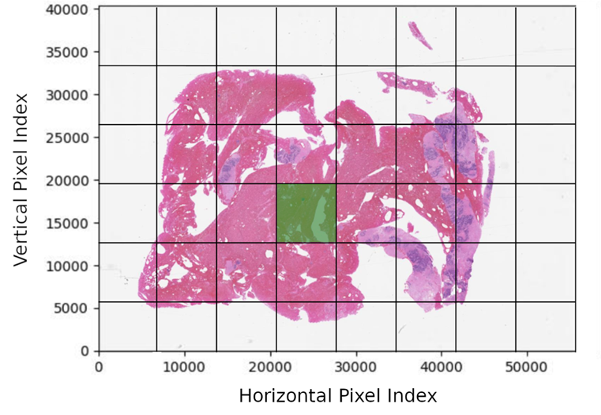
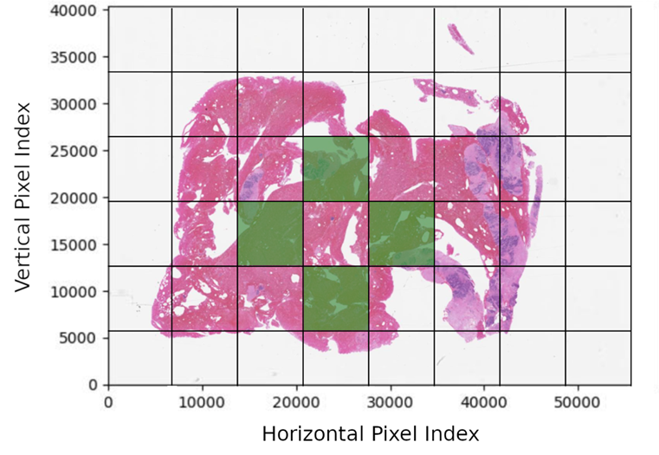
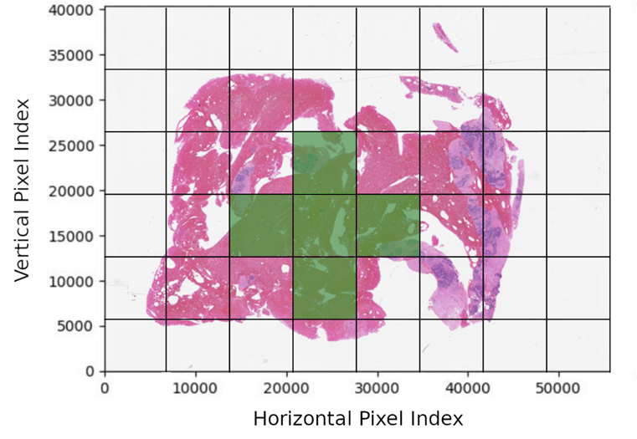
Frame to Patch Masks
Notes:
Albert
On the left we have the original image and on the right the inverted fill. When the inverted image is superimposed onto the original…

Slide 11
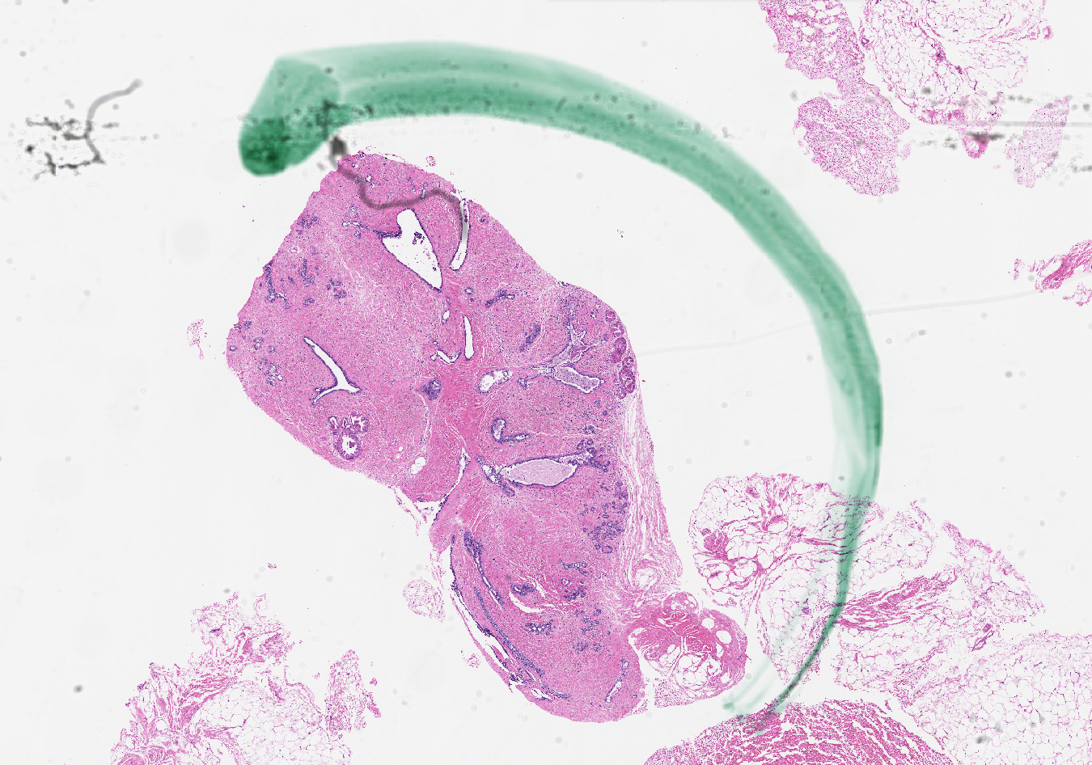


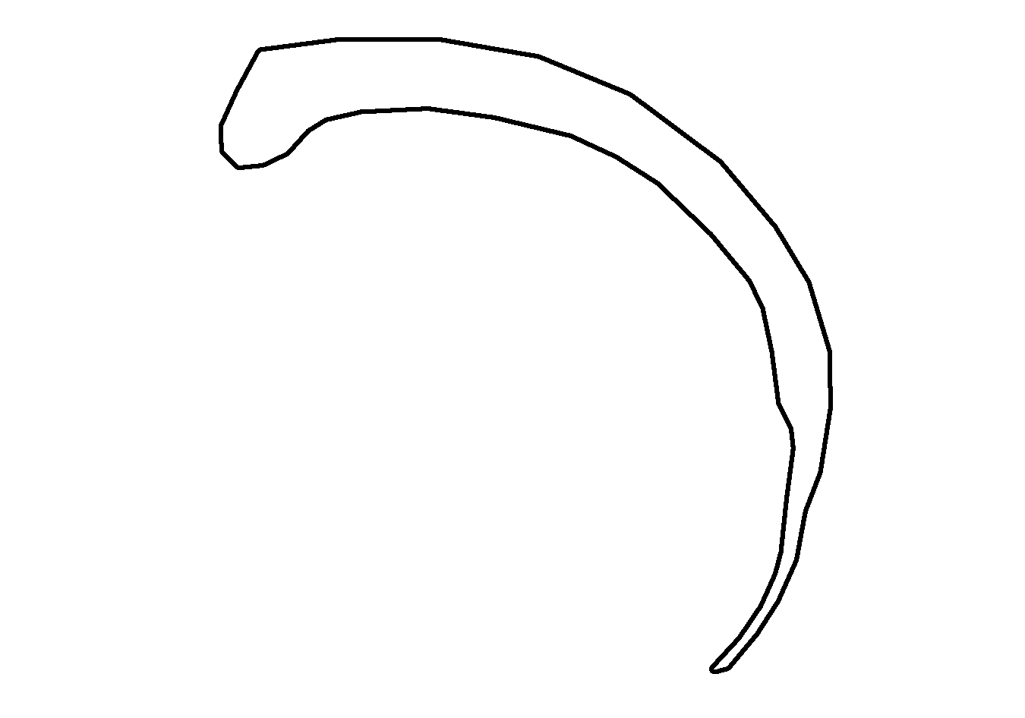

Slide Scoring
Missed
Annotations
Total
Area
Model
Predictions
Model Predictions
Area
Missed Annotations Area
Total
Area
-
=
Notes:
Albert
How do we know our model’s any good? We can look at error on a frame-by-frame basis, but we also want a holistic picture of the model’s performance. We developed a slide-scoring system that’s agnostic of the size, number and order of model predictions. Our scoring system only considers overlap between reference and hypothesis surfaces.
For example, suppose we have this region annotated by a pathologist with the artifact label.
And suppose that our model says that this area contains an artifact. How much did we get right and how much did we get wrong?
Well this green region wasn’t included, so we calculate its area and add it to the artifact’s false negative sum.
We got the red part right, so we add the area of this red set intersection to the true positive sum.
We normalize area figures by the total area of the annotation, and determine that we hit 92% of this target. We do this for every reference and hypothesis combination to populate our multiclass confusion matrix. And from the multiclass confusion matrix, we derive class-specific statistics, such as
true positives, false positives, true negatives, false negatives,
sensitivity, specificity,
F1 score and Cohen’s kappa coefficient.

Slide 12
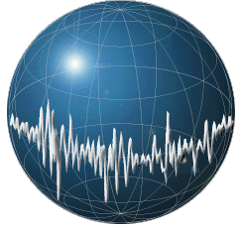

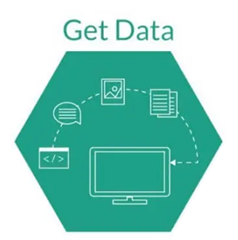
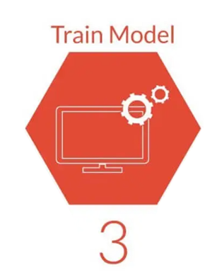
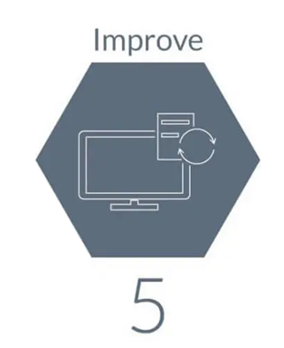
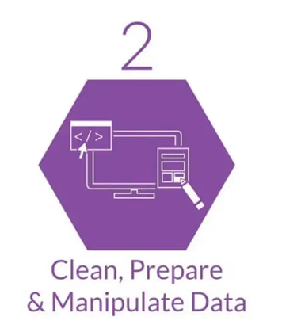
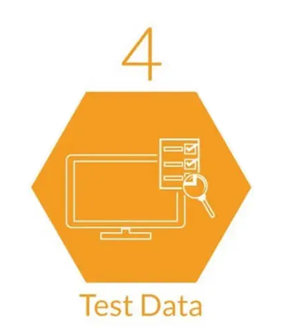
Machine LEARNING in Digital Pathology
Notes:
Leo
Morning Salutation
Introduce Everyone
Explain Graphic
Good morning, everyone! This is Team 1 and I am Albert, this is Leo, and this is Yuan. Our project is Machine Learning Applications in Digital Pathology. We are trying to build a Machine Learning System that can identify cancerous cells in biopsy slides of tissue samples. In the title slide we have a picture representation of a neural network which will be a key component in The Deep Learning algorithm we hope to implement later.

